Slide 1

RobaBookia
Responsive E-commerce

Slide 2

Project description
Welcome to RobaBookia, the ultimate online bookstore where you can discover, read, and buy your favorite books! Explore a rich collection of English titles powered by the Google Books API, or dive into our dedicated Arabic section. With easy book filtering, a seamless shopping cart, and essential pages like Contact, Sign In, and About, robaBookia offers a smooth and engaging experience for all book lovers. Find your next read with just a few clicks!

Slide 3
Team members
Ahmed Mohamed AbdelFattah
Abanob Nader
Joseph Lotfy
Mohamed Mahmoud
Marihan Ehab
Raghad Hany

Slide 4
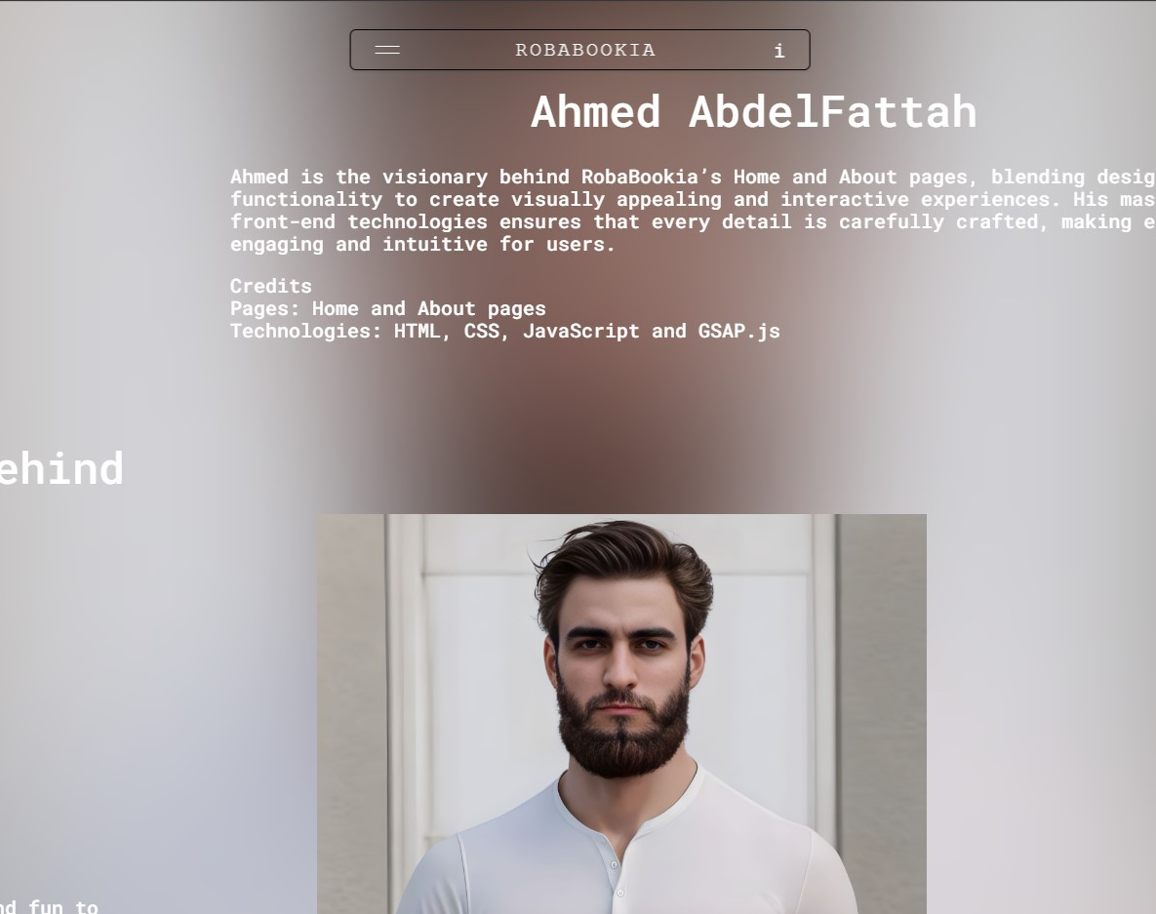
Ahmed Mohamed AbdelFattah Ahmed Mohamed AbdelFattah is key to developing RobaBookia's Home, About, and loading pages. He uses HTML for structure, CSS for design, JavaScript for interactivity, and GSAP.js for animations, ensuring the platform is functional, visually appealing, and user-friendly. His work creates an engaging and immersive experience that aligns with RobaBookia's community-focused spirit.

Slide 5

Abanoub Nader Abanob Nader is responsible for designing RobaBookia’s 404 error page, incorporating an engaging animated cube to capture user attention. Using HTML for structure and CSS for styling, he ensures the page is visually appealing and aligned with RobaBookia’s vibrant theme. The playful animation adds creativity, maintaining user engagement and reflecting the platform's friendly, community-oriented spirit, even when errors occur.

Slide 6
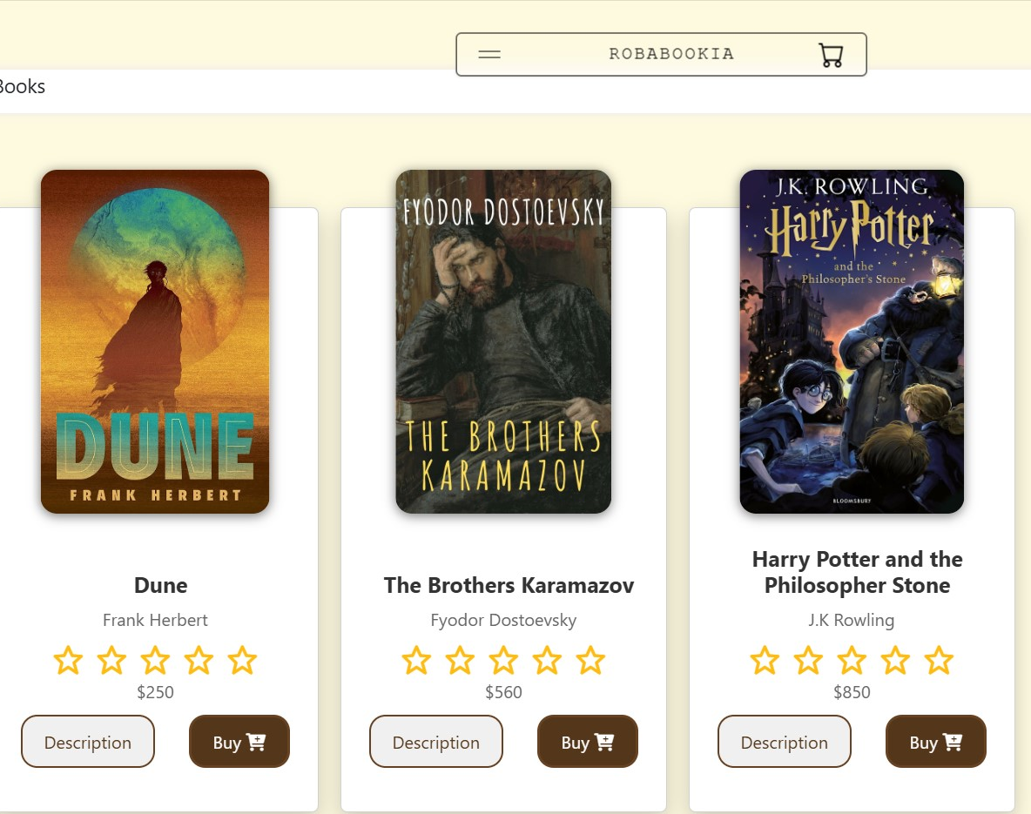
Joseph Lotfy Joseph Lotfy plays a key role in improving the book discovery and purchasing experience on RobaBookia, focusing on the English book discovery and checkout pages. By leveraging HTML, CSS, JavaScript, and API integration, he creates an intuitive user interface. His JavaScript-driven dynamic search functionality allows users to filter books by genre or the publisher. ensuring a smooth and engaging book selection and purchasing process..

Slide 7
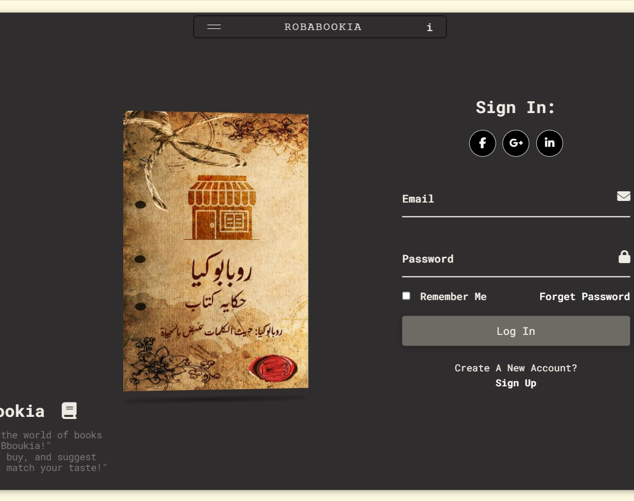
Mohamed Mahmoud Mohamed Mahmoud plays a key role in designing and developing the sign-in, sign-up pages, and footer for RobaBookia. Leveraging HTML, CSS, and JavaScript, he creates a seamless and visually appealing onboarding experience. His well-organized forms, vibrant design choices, and dynamic features like real-time input validation ensure smooth user interactions. Additionally, the footer he designed provides easy access to important links, improving overall site navigation and usability.

Slide 8
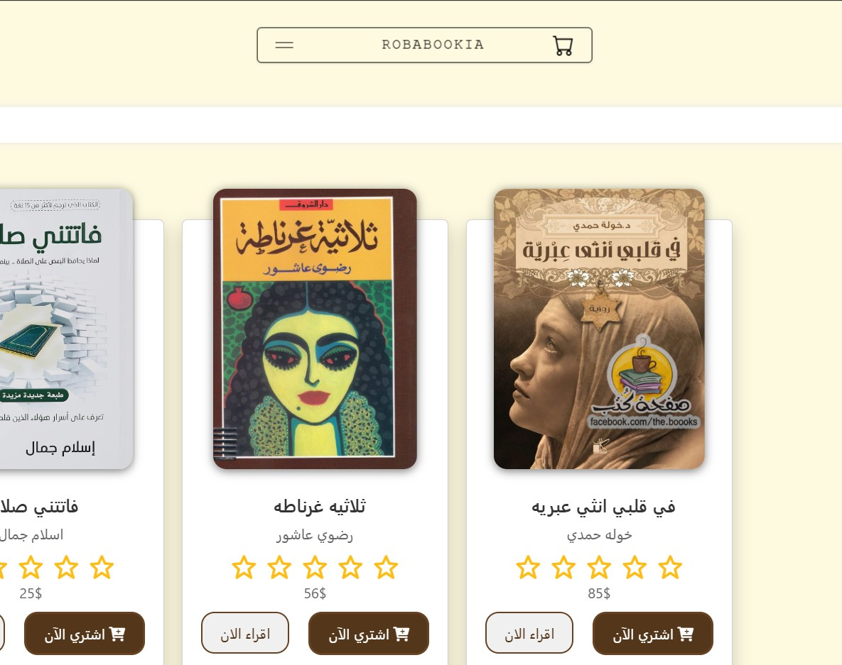
Marihan Ehab Marihan Ehab has significantly contributed to RobaBookia by developing the 'Read a Book' feature and the Arabic discovery section. Using HTML, CSS, JavaScript, and turn.js, she creates an interactive, immersive reading experience with a realistic page-turning effect. Her work ensures the platform is visually engaging and accessible, especially for Arabic-speaking readers, highlighting cultural diversity and making literature more inclusive. Marihan's efforts enhance both the aesthetic appeal and the functionality of the platform, making it easier for users to discover and enjoy Arabic literature.

Slide 9
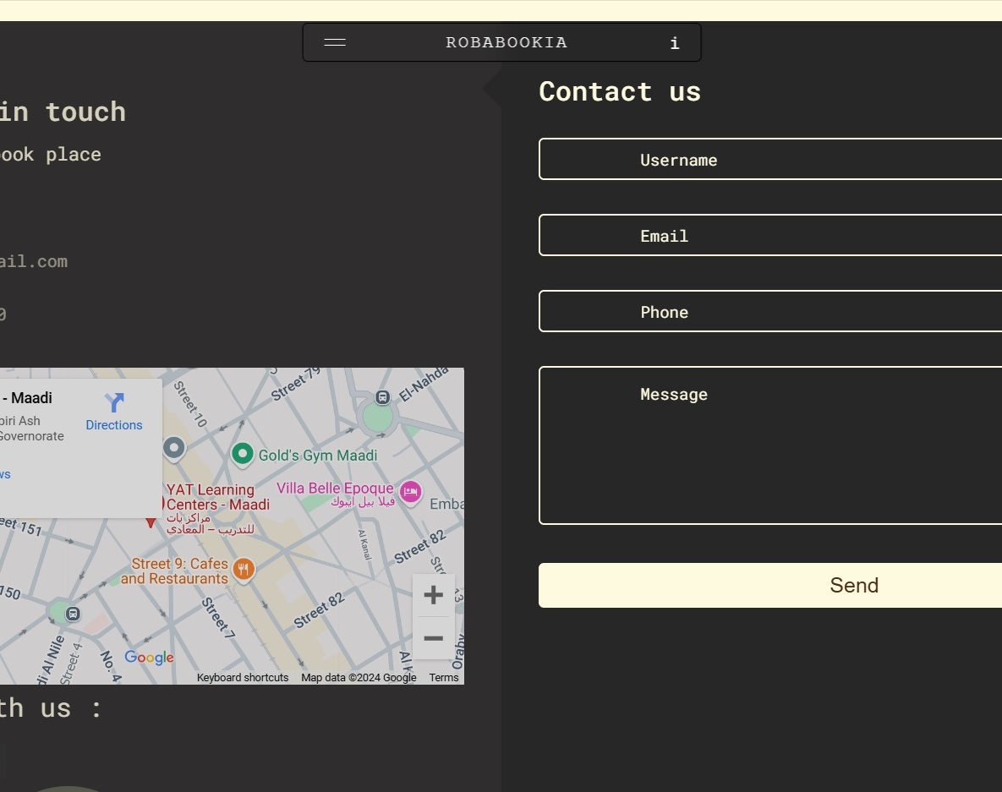
Raghad Hany Raghad Hany has been instrumental in developing RobaBookia’s contact page, creating an intuitive and visually appealing communication channel. Using HTML for structure, CSS for design, and JavaScript for real-time form validation, she ensures a seamless user experience. By integrating API connections, Raghad enables prompt delivery of user messages, helping foster a welcoming environment where users can easily reach out for support or feedback, enhancing the platform’s community-oriented feel.

